Slide 1
x
u
X
ϕ
p
L
y
v
N
Y
ψ
θ
r
q
M
z
w
Z

Slide 2
advancing side
β₀ + β_{1s}
Ω_{LR}
Ω_{UR}
relative wind
β₀ - β_{1c}
Ψ = 90°
β₀ + β_{1c}
Ψ = 180°
Ψ = 0°
β₀ - β_{1s}
Ψ = 270°
retreating side

Slide 3
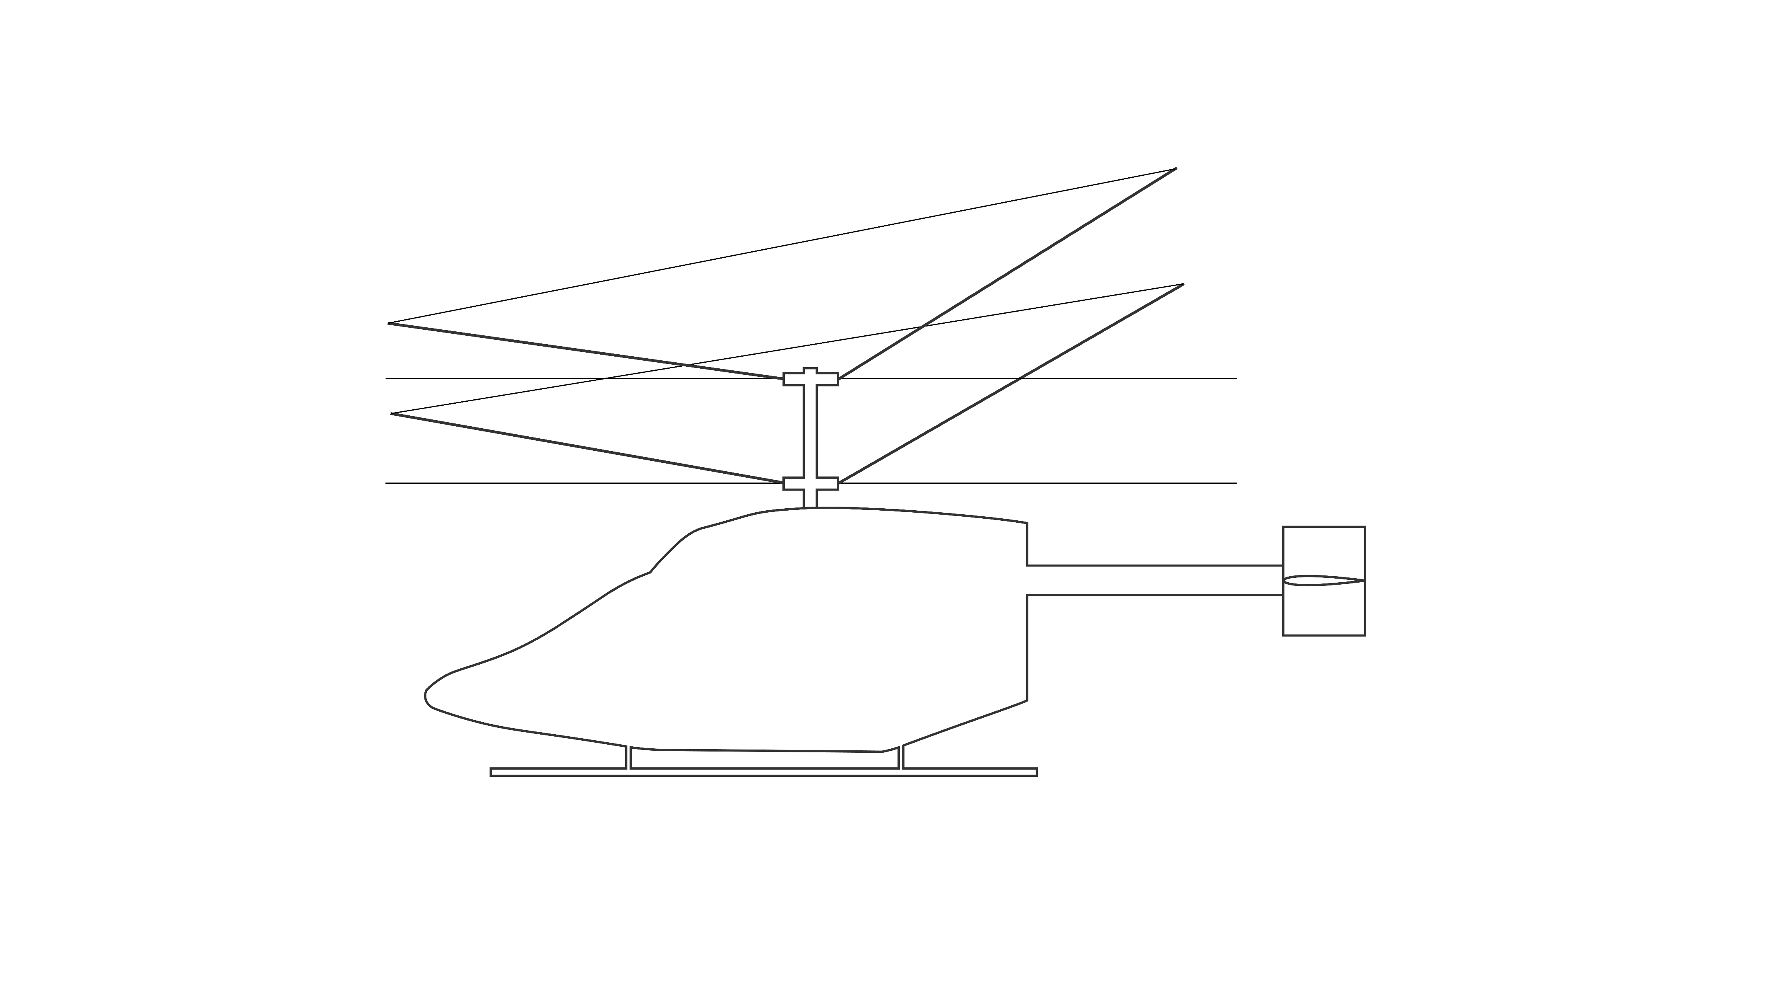
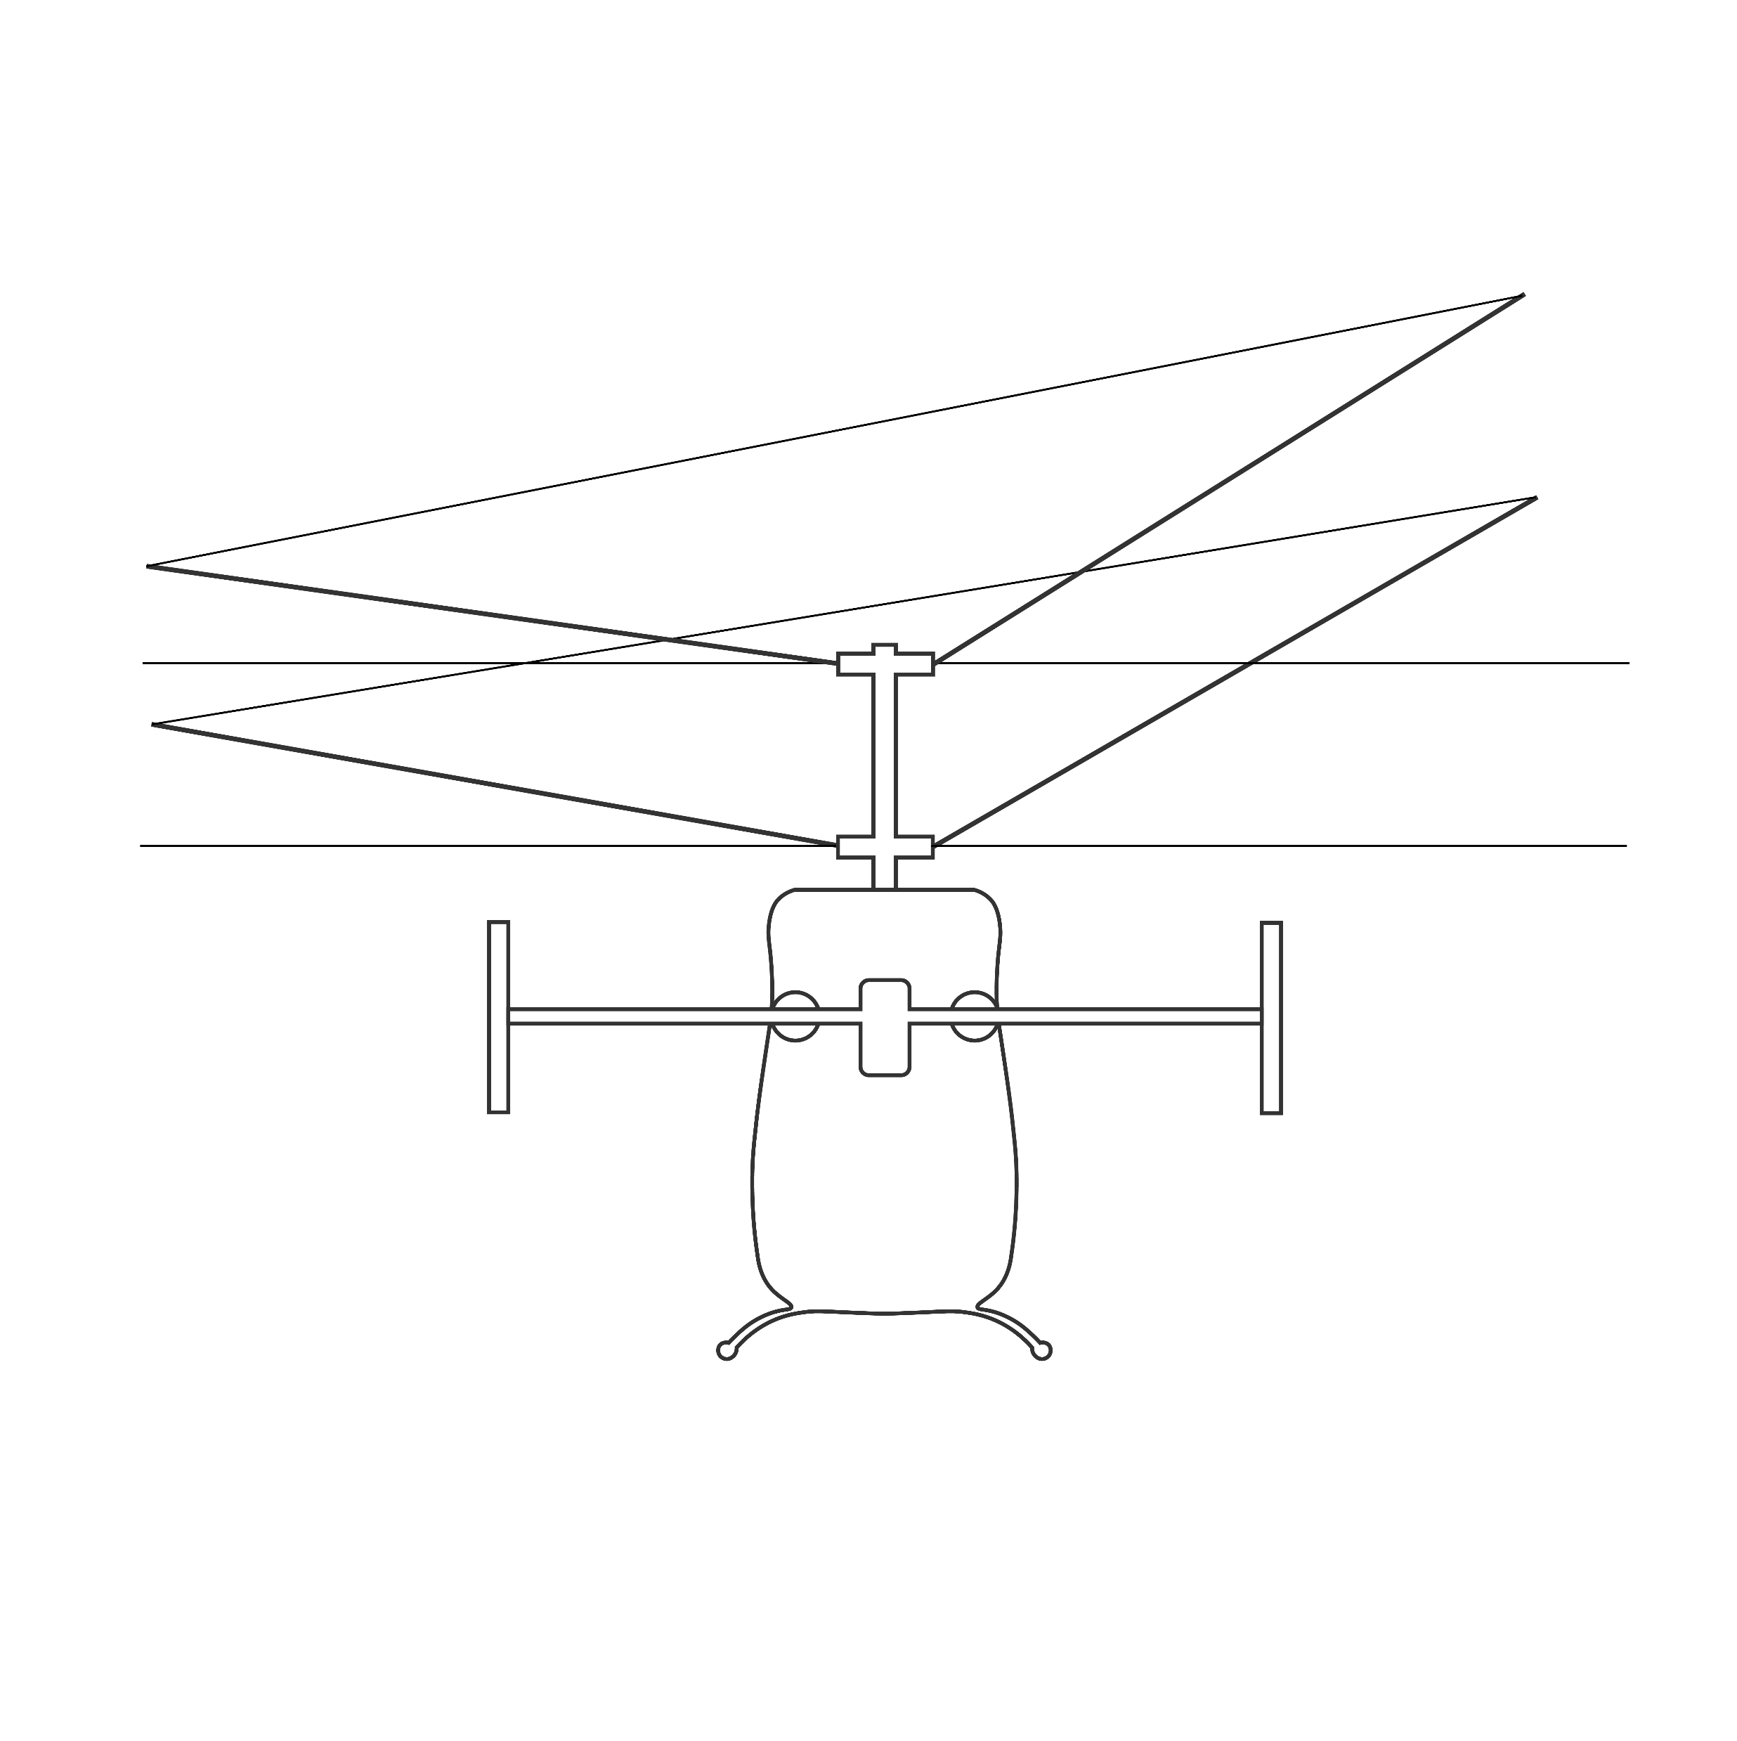
T_{UR}
T_{UR}
T_{LR}
β_{1cUR}
T_{LR}
β_{1sUR}
TPP_{UR}
TPP_{LR}
β_{1cLR}
HP_{UR}
H_{UR}
HP_{UR}
β_{1sLR}
TPP_{UR}
M_{yUR}
HP_{LR}
M_{xUR}
V
H_{LR}
HP_{LR}
L_{HT}
Y_{UR}
TPP_{LR}
θ_{FP}
M_{yLR}
h_{UR}
D_{HT}
2D_{VT}
h_{UR}
M_{xLR}
h_{LR}
h_{LR}
Y_{LR}
α_{S}
h_{HT}
h_{VT}
L_{VT}
L_{HT}
L_{F}
θ
h_{VT}
ϕ
x_{CG}
h_{HT}
L_{F}
M_{xF}
L_{VT}
M_{yF}
D_{F}
y_{CG}
Y_{F}
y
l_{HT}
x
y_{E}
x_{E}
y_{E}
x_{E}
x
l_{VT}
y
z_{E}
z
W
W
z
z_{E}

Slide 4
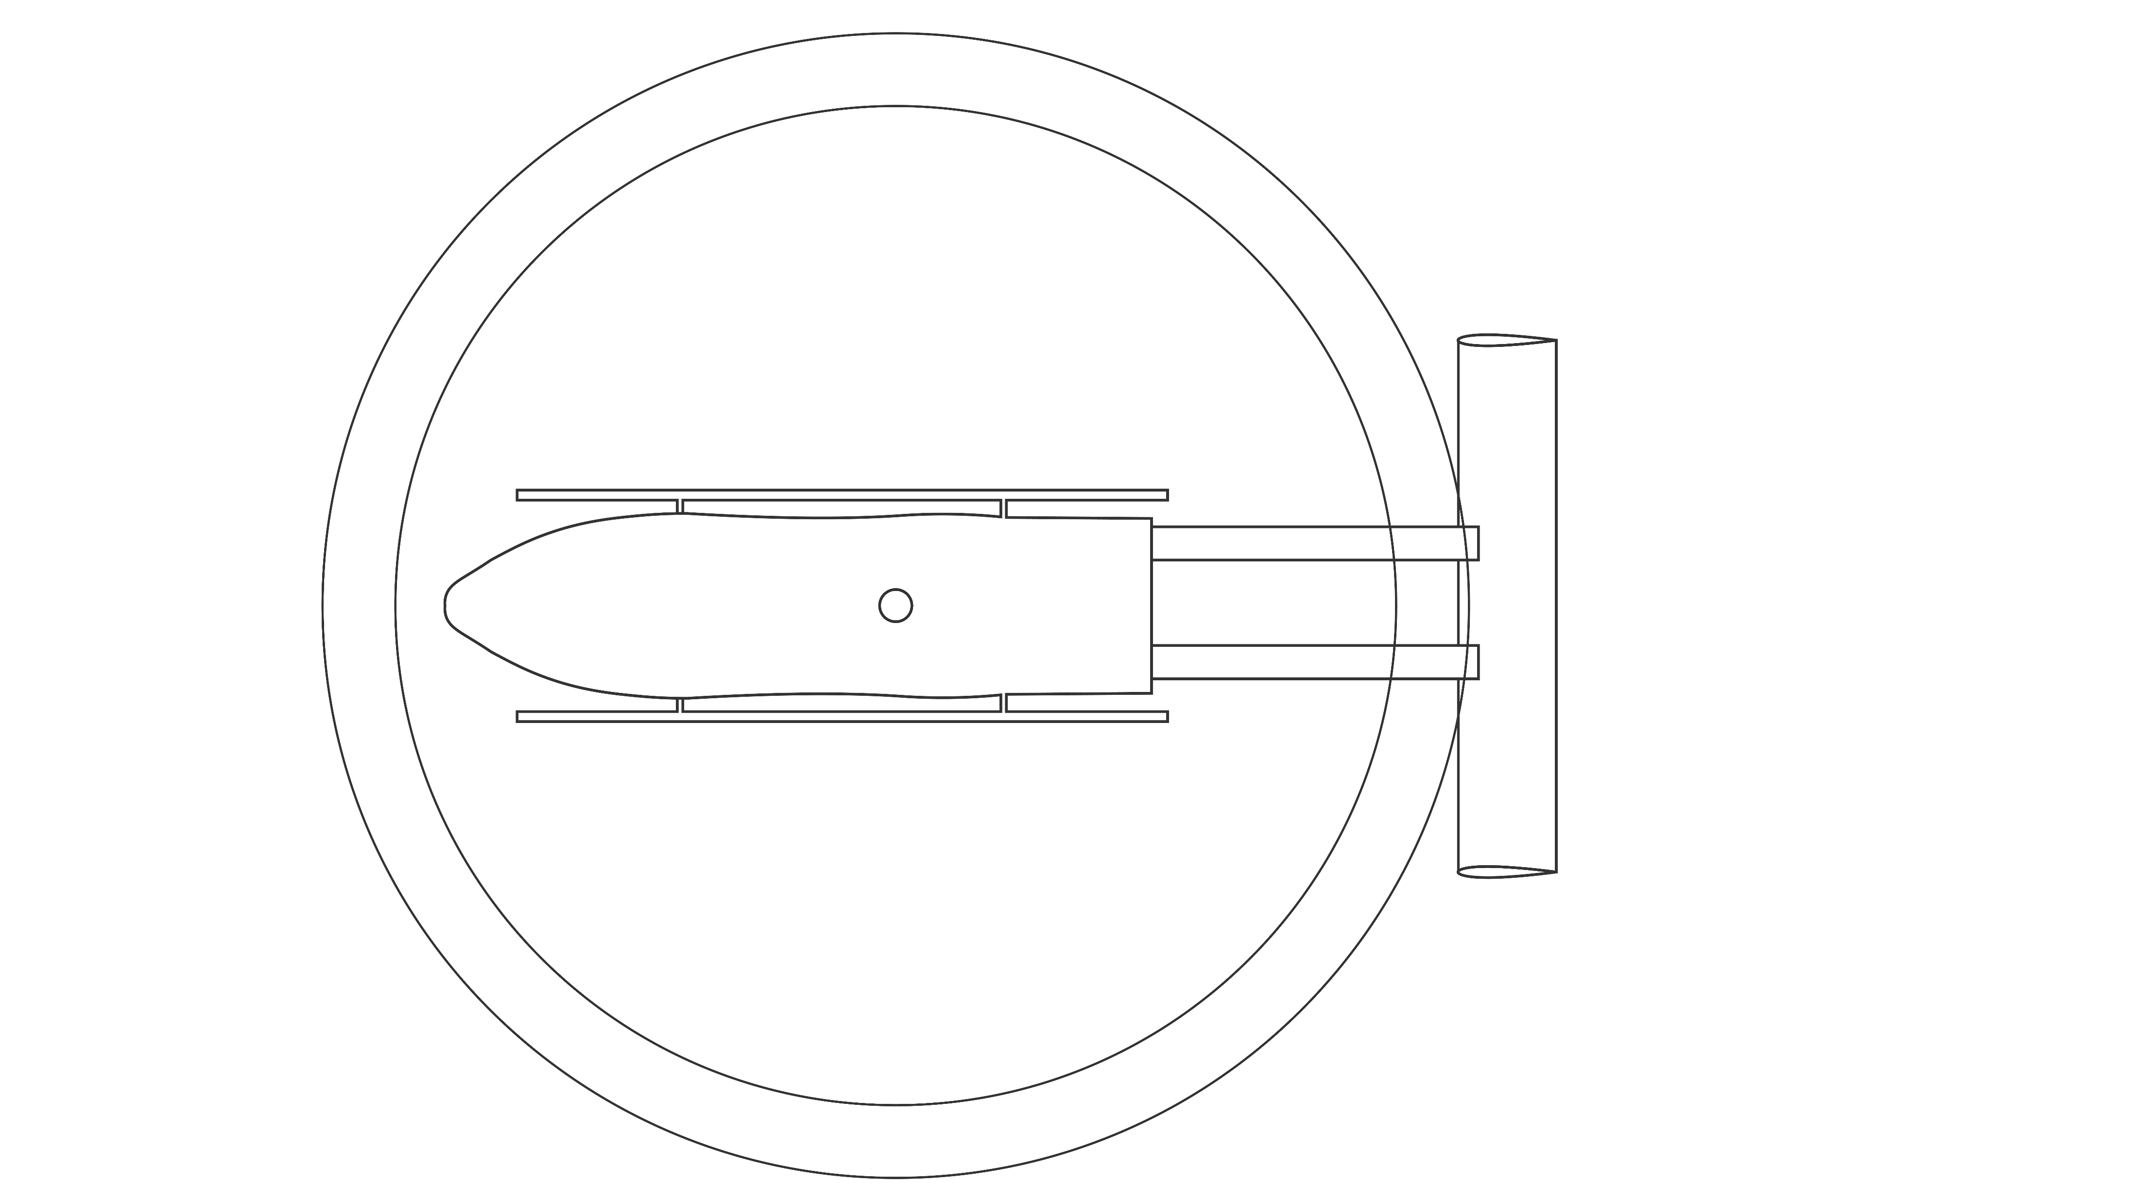
L_{VT}
l_{VT}
D_{VT}
x_{CG}
Y_{F}
Y_{LR} + Y_{UR}
y_{CG}
D_{F}
H_{LR} + H_{UR}
T_{LR}
D_{HT}
T_{UR}
L_{VT}
Q_{UR}
_{(rotor reaction torque)}
D_{VT}
y
Q_{LR}
_{(rotor reaction torque)}
x
z

Slide 5
Forces & Moments
Atmosphere
[ρ, a, μ]
Fuselage aerodynamics model
Forces
[X, Y, Z]
Rotor aerodynamics & dynamics model
State (rotor) x_{r}(t)
[β_{0UR}, β_{0LR}, β_{1cUR}, β_{1sUR}, β_{1cLR}, β_{1sLR}]
State (rotor)
Forces & Moments
State (rigid body) x(t)
[u, v, w, p, q, r, ϕ, θ, ψ]
Moments
[L, M, N]
State (inflow) x_{i}(t)
[λ_{0UR}, λ_{0LR}, λ_{1cUR}, λ_{1sUR}, λ_{1cLR}, λ_{1sLR}]
Control u(t)
[θ_{0UR}, θ_{0LR}, θ_{1c}, θ_{1s}, δ_{E}, δ_{R}]
Forces
Empennage aerodynamics model
CG
Moment of inertia
[I_{xx}, I_{yy}, I_{zz}, I_{xz}]
Mass & Payload
System & structure model

